Slide 1
AWS Developer: The Big Picture
WHAT IS AWS?

Slide 2




Slide 3

\

Slide 4

Overview
What is the “Cloud”?
Getting to the bottom of AWS Why and when to use AWS AWS vs. X

Slide 5
Elastic Compute Cloud (EC2)
Simple Storage Service (S3) Relational Database Service (RDS) Route 53
Understanding
the Core Services of
AWS

Slide 6
Elastic Beanstalk (EB)
Lambda
Enhancing Your App with
AWS
Databases and Application Services
DynamoDB
Virtual Private Cloud (VPC) CloudFront
CloudWatch

Slide 8
AWS is for Developers

Slide 9
The Web Application Conundrum

Slide 10




The Internet

Slide 11


Lisa
CEO and Very Special Person

Slide 12


Slide 13
Web applications need to scale

Slide 14


Gary
Developer Supreme

Slide 15


Slide 16

I wanna get big and strong!
Now!

Slide 17





Slide 18


Slide 19
Hello Amazon Web Services

Slide 20


I smell a business opportunity!

Slide 21

Launches first service Simple Queue Service around 2004

Slide 22
Collection of cloud computing services
Can work together or independently
Runs or supports a computer program

Slide 23



Cloud

Slide 24





Computing
SELECT * FROM myTable
GET https://mysite.com/
product, category, price
2 + 2
<html> … </html>
..wait45, no…

Slide 25
AWS is a provider of cloud services

Slide 26





Slide 27

Why Depend on AWS?
$
Low Cost
Easy Scalability

Slide 28





$$$$$$$

Slide 29
With AWS, there are no upfront costs
(for most services)

Slide 30

$$$
$$$
$

Slide 31
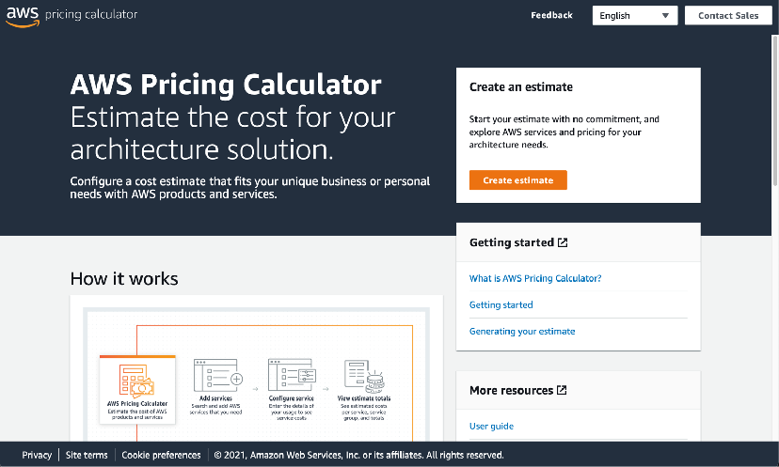
No really! Check it out here:
https://calculator.aws

Slide 32











Slide 33










Slide 34
Tracing the Global Infrastructure of AWS

Slide 35


Why Deploy Globally?
Reduced Latency
Increased Redundancy

Slide 36
Latency aﬀects the user experience

Slide 37




Singapore
Germany
USA
Germany
USA
Singapore

Slide 38
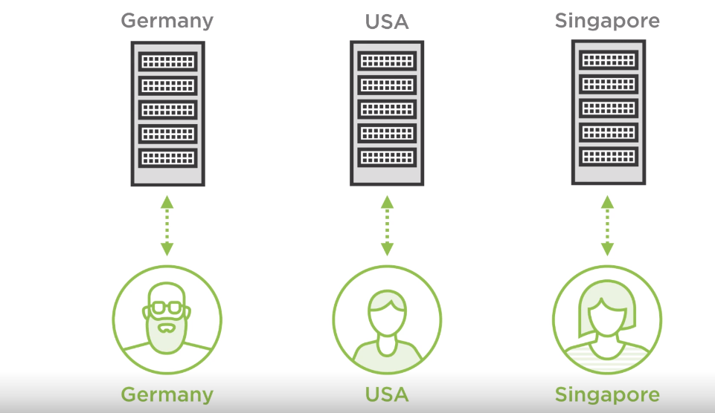

Slide 39
AWS has the most data servers

Slide 40
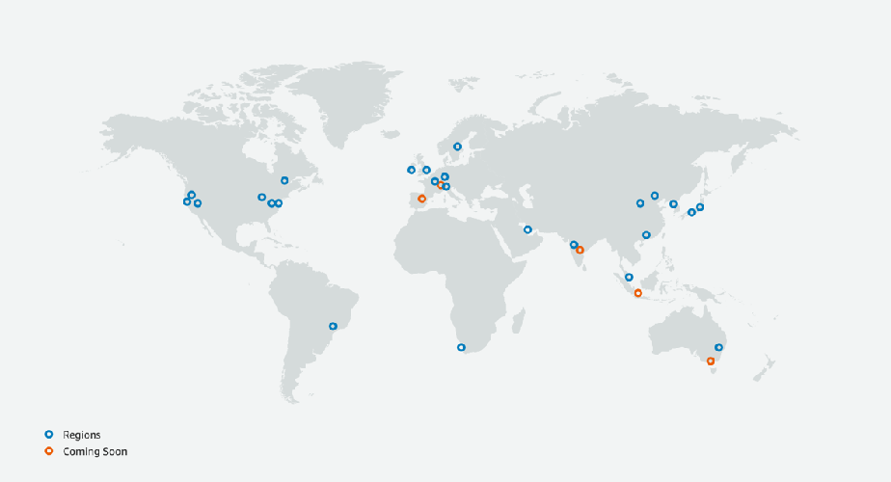
AWS Regions
May 2021

Slide 41

AWS Geographic Organization
Region
Availability
Zone
Data
Center

Slide 42
Scaling across Regions and AZ’s increases redundancy

Slide 43
AWS Service Health Dashboard
https://status.aws.amazon.com/

Slide 44
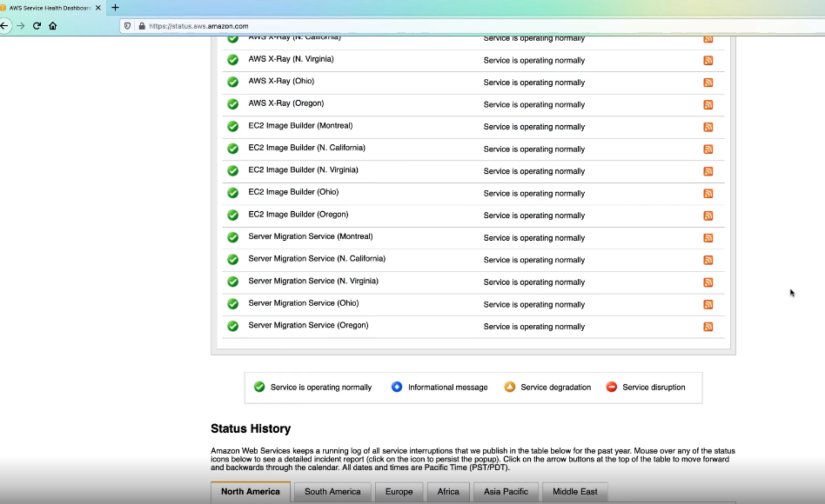

Slide 45
How Does AWS Work?

Slide 46





Virtual Private Cloud

Slide 47





Local Development

Slide 48




Security Group
Security Group
Instance
Instance
Instance

Slide 49
Remember…

Slide 50
AWS vs. the Rest

Slide 51

Cloud services provider started around 2010

Slide 52




Slide 53

Robust service oﬀerings
Robust service oﬀerings
Strong global reach
Strong global reach
Best place to run Microsoft products
Better web console

Slide 54
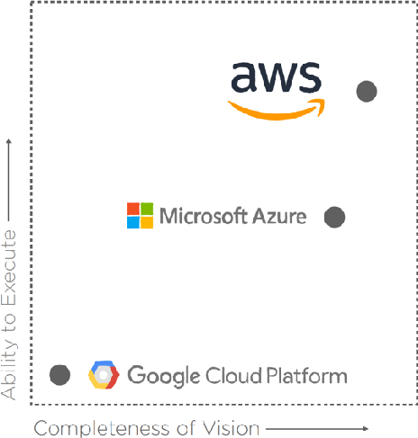
2019 Gartner IAAS Magic Quandrant Leaders

Slide 55

Cloud services provider started around 2011

Slide 56
Specializations in Big Data, Kubernetes, and AI
Strong global reach
12x more market share
Strong global reach
Better web console

Slide 57

Cloud services provider started around 2007

Slide 58





2N0o0w7

Slide 59
Heroku app deployment is dead simple…

Slide 60
…but it lacks the breadth and reach of AWS

Slide 61
Conclusion

Slide 62
Web apps love the cloud
The birth of AWS
Price, scalability, and location AWS service interactions Azure, GCP, Heroku
Summary

Slide 63
Understanding the Core Services of AWS

Slide 64




AWS Core Services
EC2
S3
RDS
Route53

